Slide 1
Oliver Wronka | axxessio GmbH - Bonn
Resilient Microservices
Tag 4

Slide 2
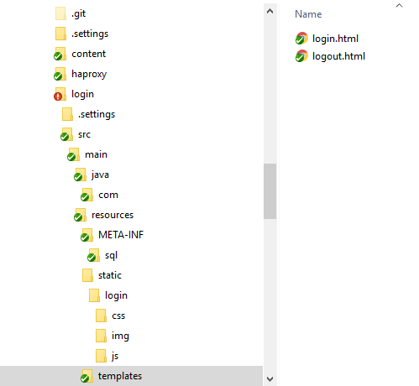
Verzeichnis Setup
pom.xml (Auszug)
<dependency>
<groupId>org.springframework</groupId>
<artifactId>spring-webmvc</artifactId>
</dependency>
<dependency>
<groupId>org.springframework.boot</groupId>
<artifactId>spring-boot-starter-thymeleaf</artifactId>
</dependency>
<dependency>
<groupId>org.springframework.boot</groupId>
<artifactId>spring-boot-starter-web</artifactId>
</dependency>
MvcConfig.java (Auszug)
@Configuration
public class MvcConfig extends WebMvcConfigurerAdapter {
@Override
public void addViewControllers(final ViewControllerRegistry registry) {
registry.addViewController("/login").setViewName("login");
registry.addViewController("/logout").setViewName("logout");
}
}

Slide 3
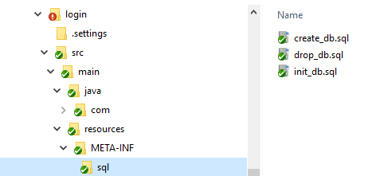
DB Setup
<properties>
<!-- enable these properties while you want to use embedded derby db -->
<property name="javax.persistence.jdbc.driver" value="org.apache.derby.jdbc.EmbeddedDriver" />
<property name="javax.persistence.jdbc.url" value="jdbc:derby:memory:LoginDB;create=true" />
<!-- enable these properties while you want to use network derby db -->
<!--
<property name="javax.persistence.jdbc.driver" value="org.apache.derby.jdbc.ClientDriver" />
<property name="javax.persistence.jdbc.url" value="jdbc:derby://localhost:1527/C:\DerbyDB\LoginDB;create=true" />
-->
<property name="javax.persistence.jdbc.user" value="login_user" />
<property name="javax.persistence.jdbc.password" value="S3cr3ts!" />
<property name="javax.persistence.schema-generation.database.action" value="drop-and-create"/>
<property name="javax.persistence.schema-generation.create-source" value="script"/>
<property name="javax.persistence.schema-generation.create-script-source" value="META-INF/sql/create_db.sql"/>
<property name="javax.persistence.sql-load-script-source" value="META-INF/sql/init_db.sql"/>
<property name="javax.persistence.schema-generation.drop-source" value="script" />
<property name="javax.persistence.schema-generation.drop-script-source" value="META-INF/sql/drop_db.sql" />
<property name="hibernate.dialect" value="org.hibernate.dialect.DerbyDialect"/>
<properties>
<!-- enable these properties while you want to use embedded derby db -->
<property name="javax.persistence.jdbc.driver" value="org.apache.derby.jdbc.EmbeddedDriver" />
<property name="javax.persistence.jdbc.url" value="jdbc:derby:memory:LoginDB;create=true" />
<!-- enable these properties while you want to use network derby db -->
<!--
<property name="javax.persistence.jdbc.driver" value="org.apache.derby.jdbc.ClientDriver" />
<property name="javax.persistence.jdbc.url" value="jdbc:derby://localhost:1527/C:\DerbyDB\LoginDB;create=true" />
-->
<property name="javax.persistence.jdbc.user" value="login_user" />
<property name="javax.persistence.jdbc.password" value="S3cr3ts!" />
<property name="javax.persistence.schema-generation.database.action" value="drop-and-create"/>
<property name="javax.persistence.schema-generation.create-source" value="script"/>
<property name="javax.persistence.schema-generation.create-script-source" value="META-INF/sql/create_db.sql"/>
<property name="javax.persistence.sql-load-script-source" value="META-INF/sql/init_db.sql"/>
<property name="javax.persistence.schema-generation.drop-source" value="script" />
<property name="javax.persistence.schema-generation.drop-script-source„ value="META-INF/sql/drop_db.sql" />
<property name="hibernate.dialect" value="org.hibernate.dialect.DerbyDialect"/>

Slide 4
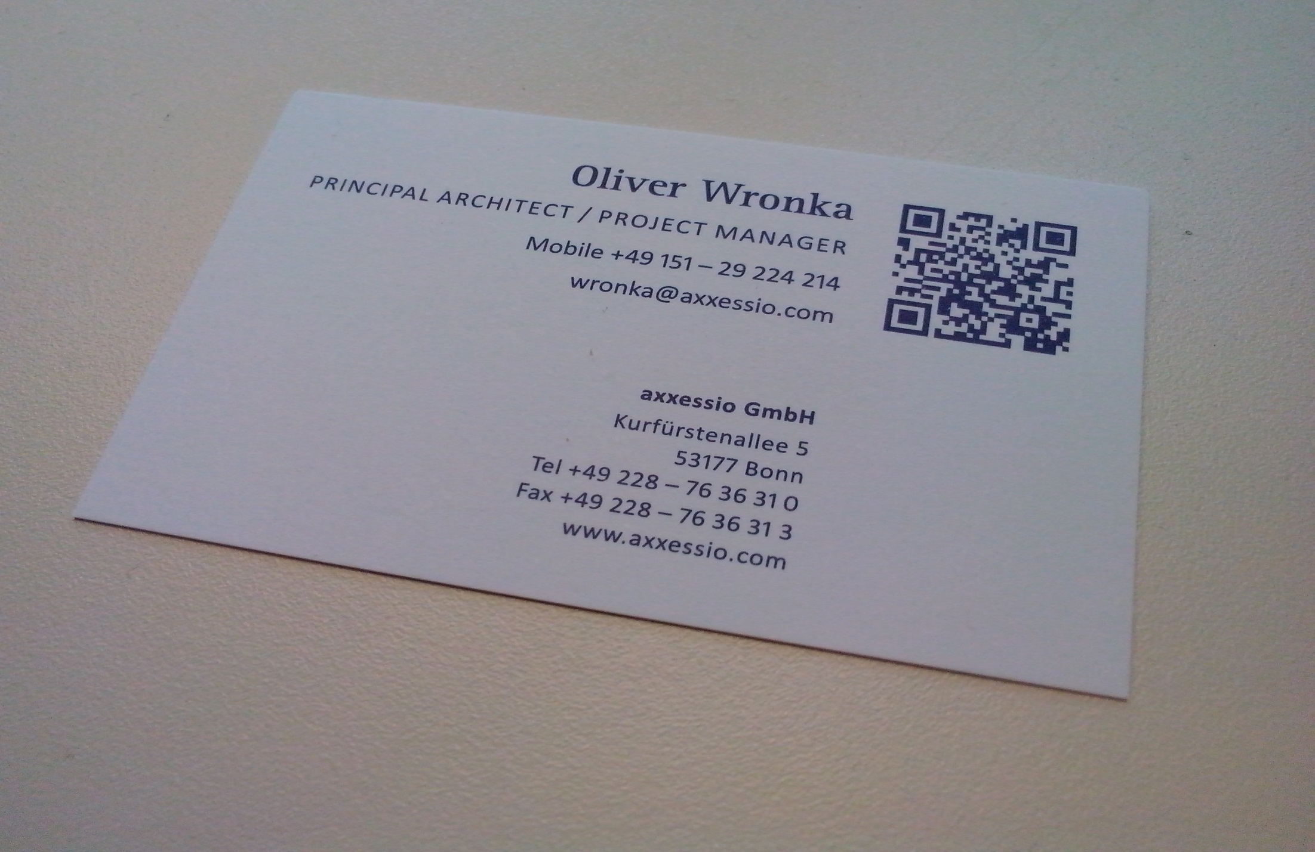
axxessio Consider IT done!
4

Slide 5
Backup

